Slide 1
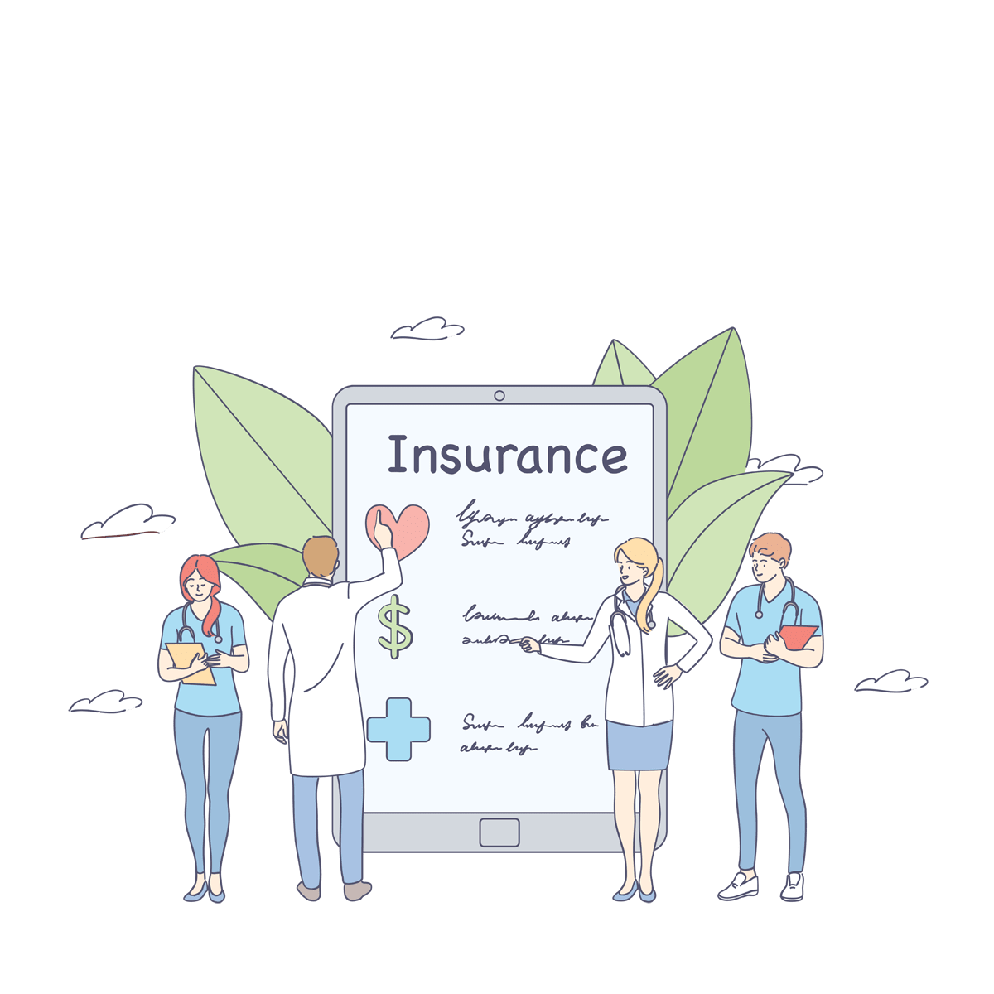
Health Insurance System

Slide 2
What is an EMR Integration ?
What is a Health Insurance System?
A health insurance system refers to software platforms or applications designed to manage and streamline various aspects of health insurance operations.
These systems assist in automating tasks related to policy administration, claims processing, member enrollment, billing, and customer service.
They help insurance companies, healthcare providers, and policyholders to effectively manage insurance-related processes, improve efficiency, and enhance overall service quality.
Popular Health Insurance Systems:
eHealthInsurance
Healthcare.gov
Oscar Health

Slide 3
Functional Requirements :
Tools Used
Any IDE (STS),Eclipse
Visual Studio Code
MySQL Database
Postman
GitHub – collaboration
Technologies Used
Front-End:
React
Redux
JavaScript
Material UI
Bootstrap
Back-End:
Spring boot
Spring security
Spring cloud API gateway
Spring jpa
Spring Java Mail
Spring Scheduler

Slide 4
Non-Functional Requirements
Availability
The system must be accessible for a user at a given point of time.
User requires a good Internet connection to access the application from anywhere
Example
The application must be present 24x7 for the user.
The system must be resilient and fault tolerant.
The user must have a strong Internet connection

Slide 5
Non-Functional Requirements
Security
Assures all data inside the system or its part will be protected against malware attacks or unauthorized access.
Example
The User details gateway must be secure using the security framework like in spring we use Spring Boot Security for user authentication, authorization

Slide 6
Spring Security for Project
The API Gateway will incorporate the inclusion of spring security.
Spring Security is a powerful and highly customizable authentication and access-control framework.
It is the de-facto standard for securing Spring-based applications.
Because the microservices operate on distinct ports, their access is exclusively through the API gateway.
Therefore, by ensuring the security of the gateway, we can effectively protect all the microservices.
We can use them to ensure the security of user details and at the userpolicy process part.

Slide 7
Project Details

Slide 8
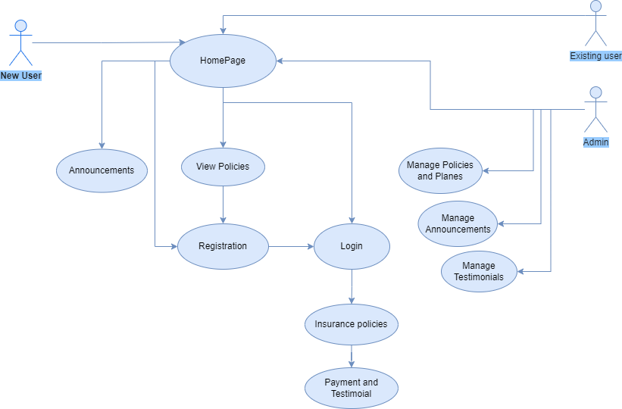
Use Case
Diagram

Slide 9
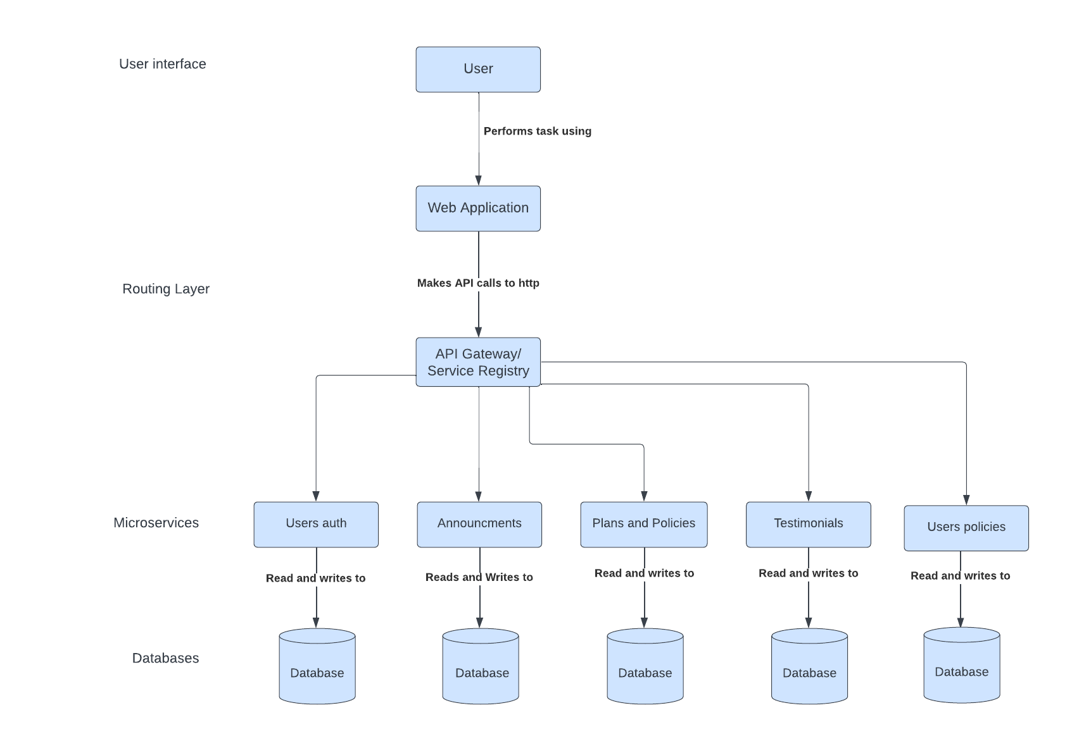
Data Flow
Diagram- User

Slide 10
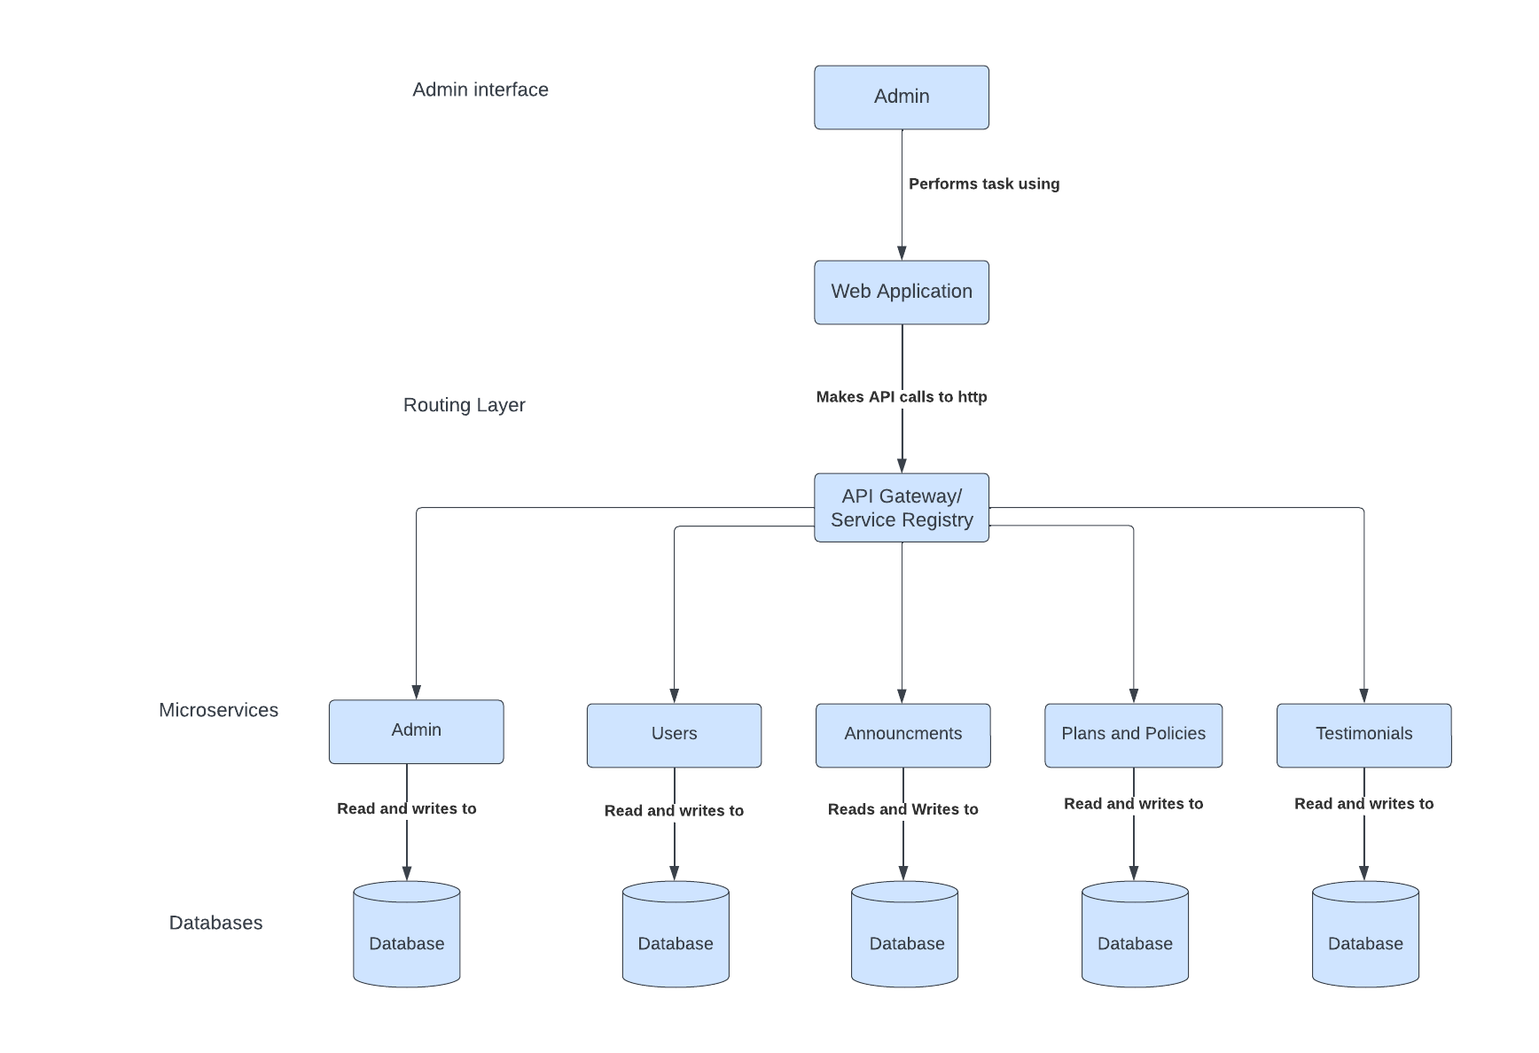
Data Flow
Diagram- Admin

Slide 11


Unit Testing
Backend-Junit testing
2) Frontend- Cypress

Slide 12
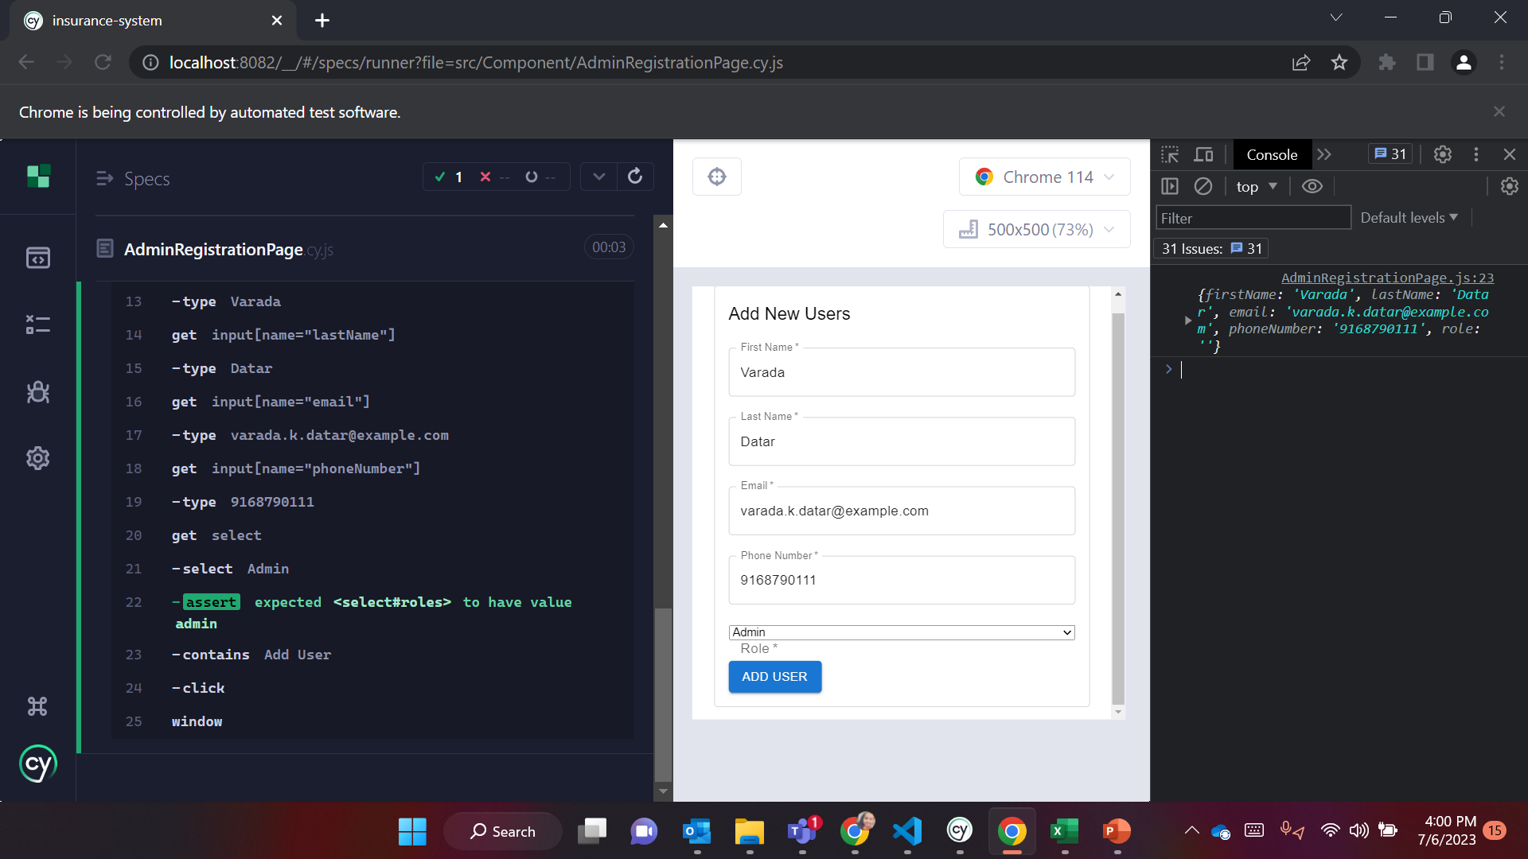
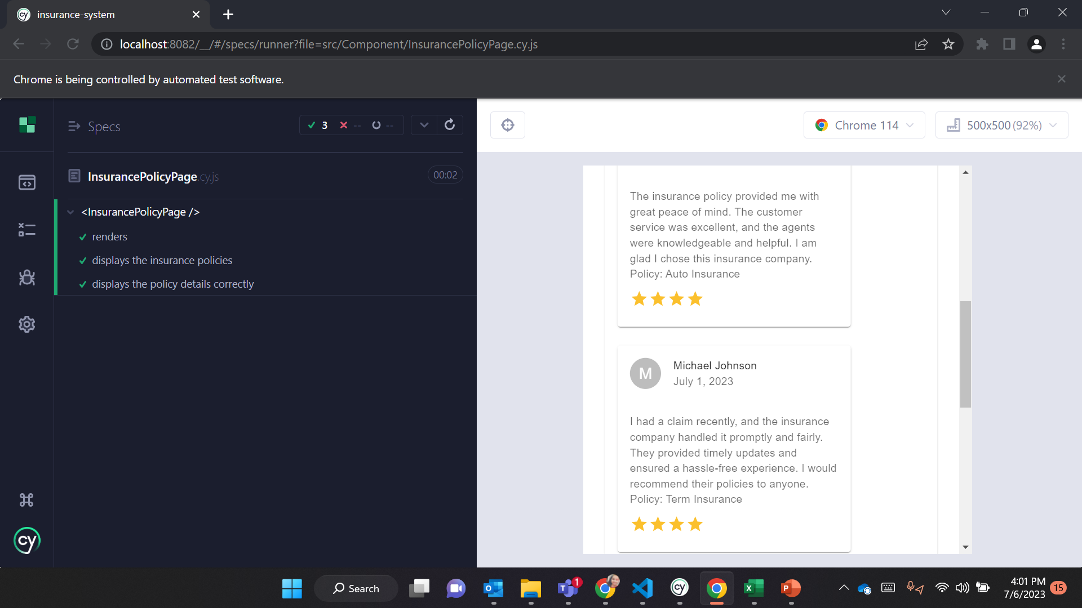
Testing Results
Admin Registration Page
InsurancePolicy Page

Slide 13
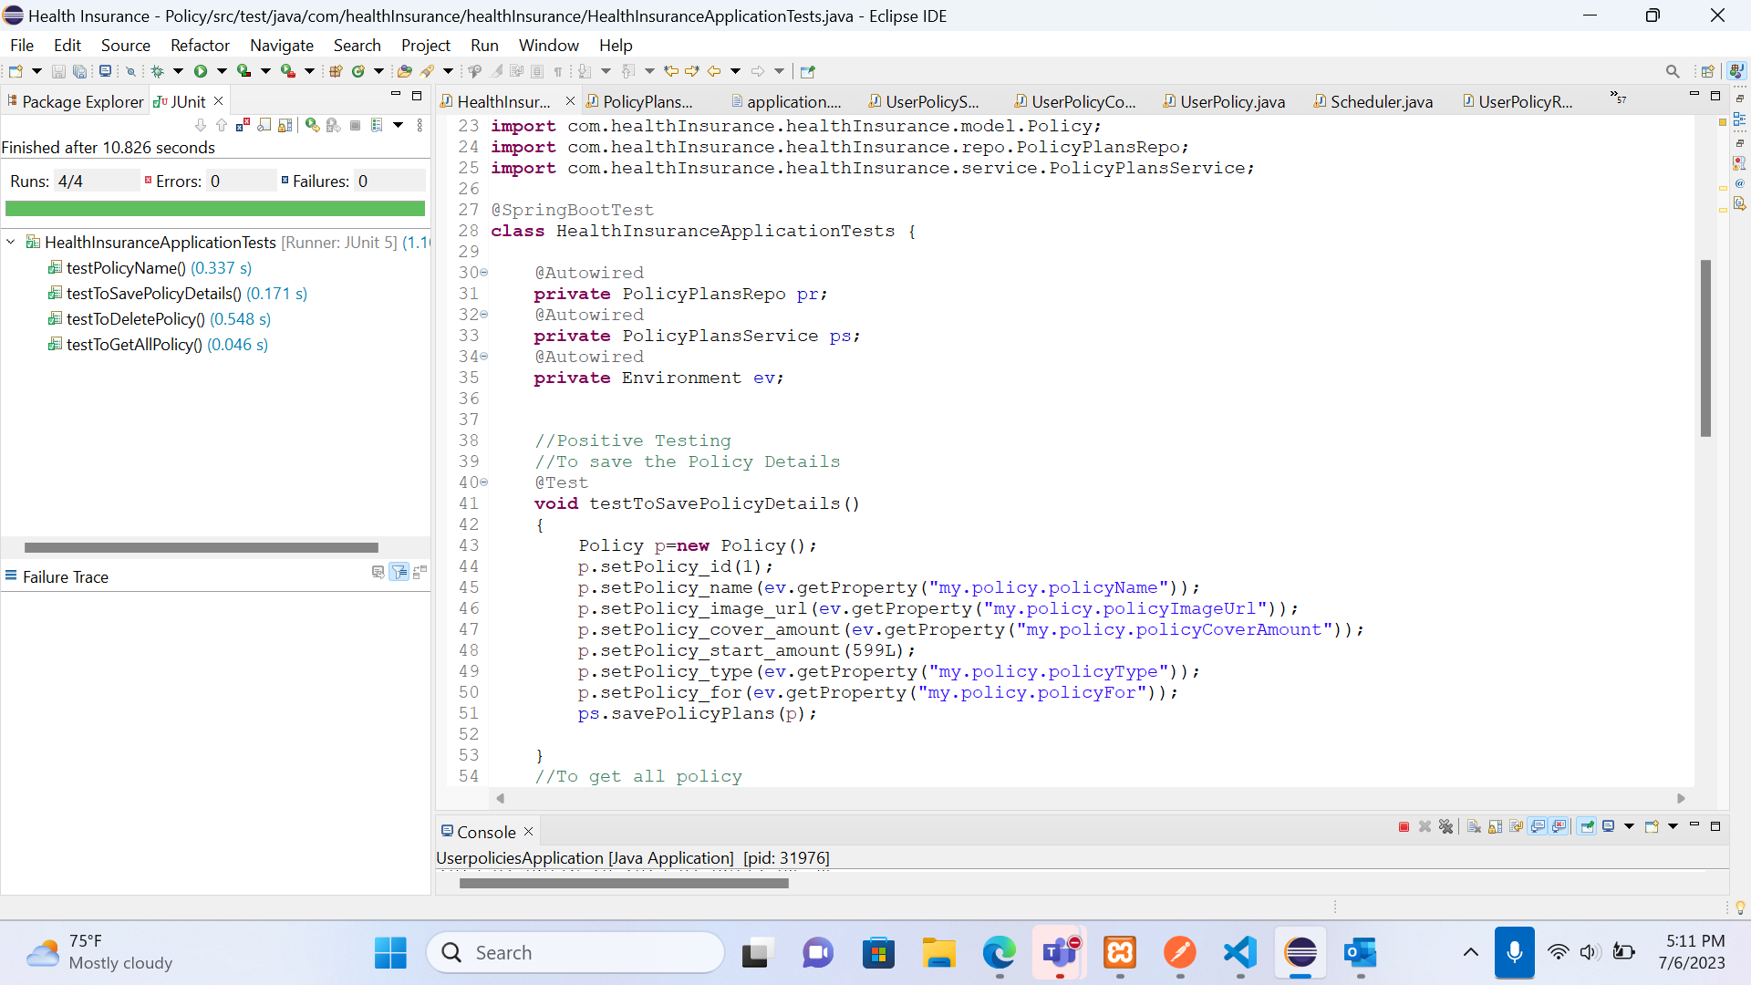
Testing Results
Policy Service

Slide 14
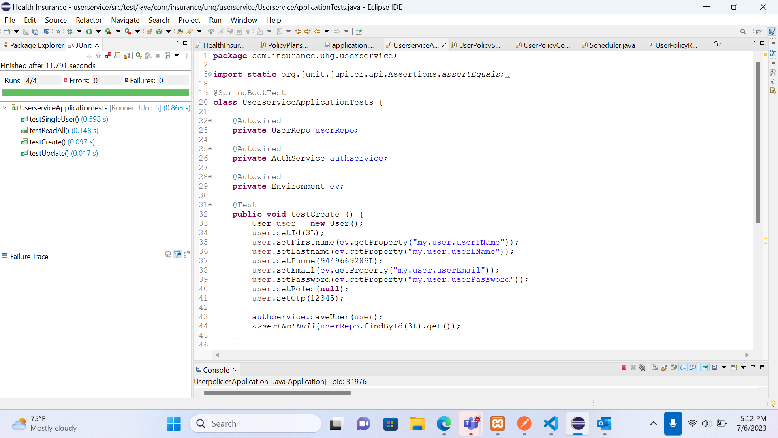
Testing Results
User Service

Slide 15
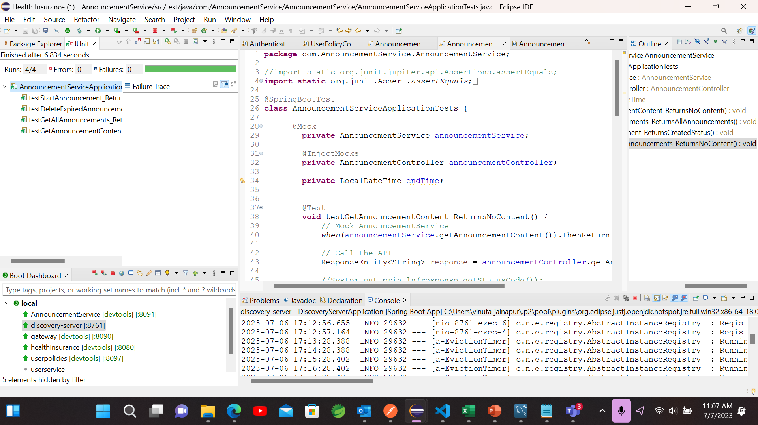
Announcement Service

Slide 16
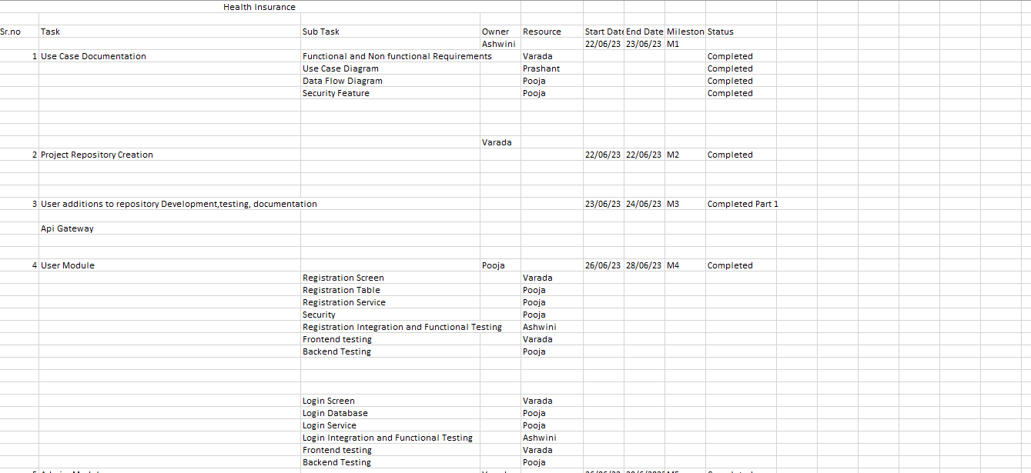
Project Plan

Slide 17

Our Team
Name | Role
Prashant Mendhe | Front-end Developer
Varada Datar | Front-end Developer
Vinuta Jainapur | Back-end Developer
Ashwini Kadadas | Front-end Developer
Pooja Guttal | Front-end Developer
Veersagar Randive | Back-end Developer

